Slide 1
New Approach to the Garbage Code classification in GBD2016
Strengthening the quality of information on causes of death in Brazil
October 3- 2017 Porto de Galinhas / Pernambuco / Brazil
Mohsen Naghavi MD, MPH, PhD
Professor of Global Health Department

Slide 2
Top down hierarchical GBD cause list (GBD map for causes of death)
Group A: Communicable, maternal, perinatal and nutritional conditions (level 1)
Diarrhea, lower respiratory, and other common infectious diseases (level 2)
Diarrheal disease (level 3)
Cholera (level 4)
Group B: Non communicable diseases(level 1)
Cardiovascular and circulatory diseases (level 2)
4. Cerebrovascular disease (level 3)
b. Hemorrhagic stroke (level 4)
Group C: Injuries (level 1)
Transport Injuries (level 2)
Road injury (level 3)
injury - motorized two-wheeler rider (level 4)

Slide 3
ICD CODES FOR THIS CAUSE
Level 1 cause (CMNND)
Level 2 cause (child inf)
Level 3 cause (meningitis )
Level 4 cause (Meningococcal meningitis)
Level 5 cause (Acute meningococcal meningitis)
Level 6 cause meningitis +meningococcal -heart diseases)
A00-B99,J.., O..,P,G.. (except A40-42)
Causes Of Death does not include A56 ,A67
A00-A010,A33-39, B4.-B6, G.., J..
COD does not include: J05.10
A39.00-A39.99 G00.0-G09.00
COD does not include G06-G07
COD does: same exact
A39.00-A39.99
In ICD10 We mapped 41,631and & in ICD9 21,214 3-6 digits code
A39.50-A39.89
A39.50-A39.59

Slide 4
Critical challenges in the causes of death data
1- Different type of input data
2- completeness
3- Different format of coding in input data
4- Age, sex unknown and impossible causes in some ages and sexes
5- Garbage Coding
6- Hided HIV in other causes
7- Miss assignment of some causes

Slide 5
Critical challenges: - completeness
Sensitivity test in GBD 2010 showed :
In low completeness data, cause composition can be a little different
VR completeness was estimated as the number of deaths registered divided by the number of deaths estimated in the GBD mortality envelope.
We dropped whole location year with lower than 50% completeness
Between 50-69% considered as noon representative

Slide 6
Completeness of Death registration system in Brazil by states for three last years

Slide 7
Critical challenges: Garbage Codes
Septicemia
Senility
Headache
Ill-defined and unspecified causes of mortality
Heart failure
Atherosclerosis
Low back pain
Infertility
Cardiac arrest
Injury unspecified
Some ICD codes or some causes that cannot be underlying causes of death

Slide 8
Garbage Codes from ICD10 (Number of codes)
Code group |  | number
ill-defined and impossible causes of death |  | 1757
Symptoms, signs and abnormal findings |  | 400
unknown ICD cod |  | 35
intermediate causes |  | 400
Immediate causes |  | 10
hypertension and Atherosclerosis |  | 13
Garbage codes in Neoplasm chapters |  | 150
Garbage code in Injury chapters |  | 104
unspecified cause or Sequelae in each Chapters (except Injuries and Cancer) |  | 165
 | total | 3034
 | nature of injuries(S, T code) | 2470
 | Provisional assignment of new diseases of uncertain etiology(U code) | 198
 | service code (Z code) | 775
total |  | 6477
Impossible cause –very bad
Non underlying cause
Unspecified underlying cause
Unacceptable for cause of death

Slide 9
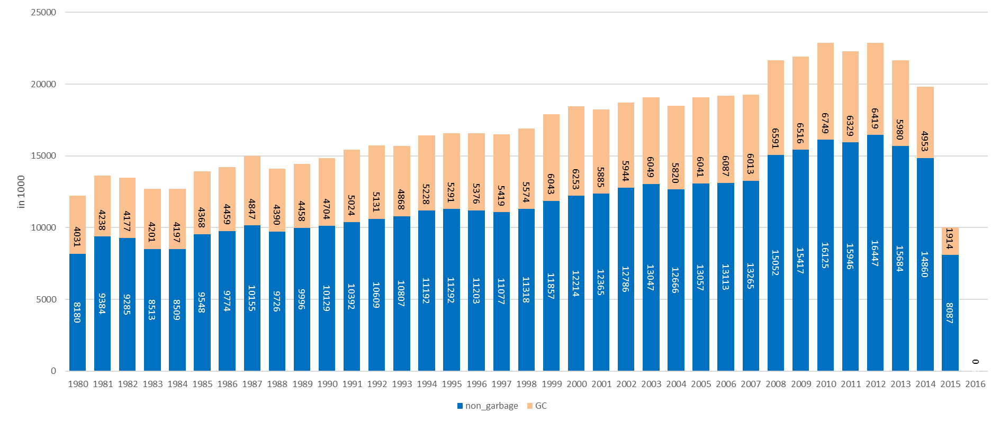
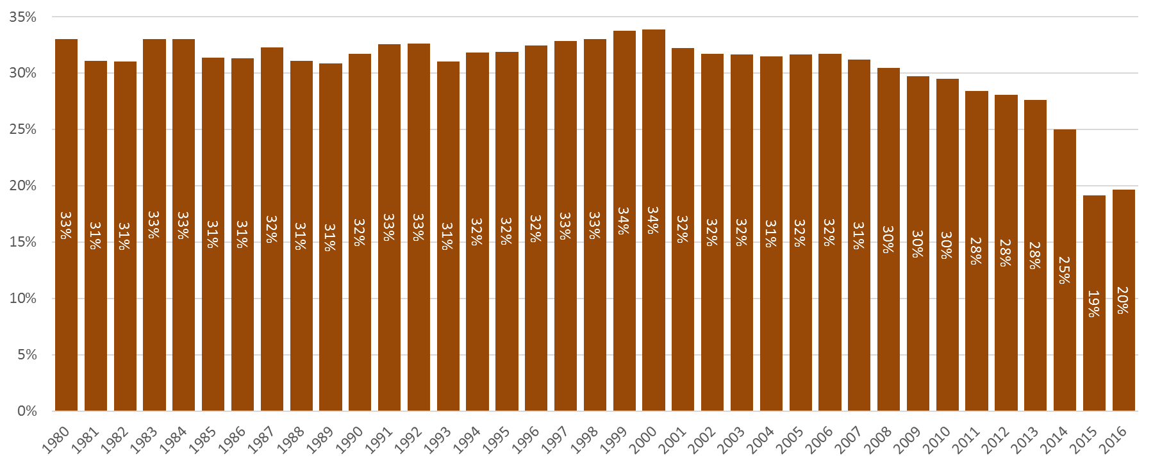
Global number (in thousands) of death reported in Vital Registration by years until April 2017- by Garbage Codes and Non Garbage Codes

Slide 10
GC fraction in Brazil VR data: by state, comparison between 2005 and 2015

Slide 11
Brazil . % of GC

Slide 12
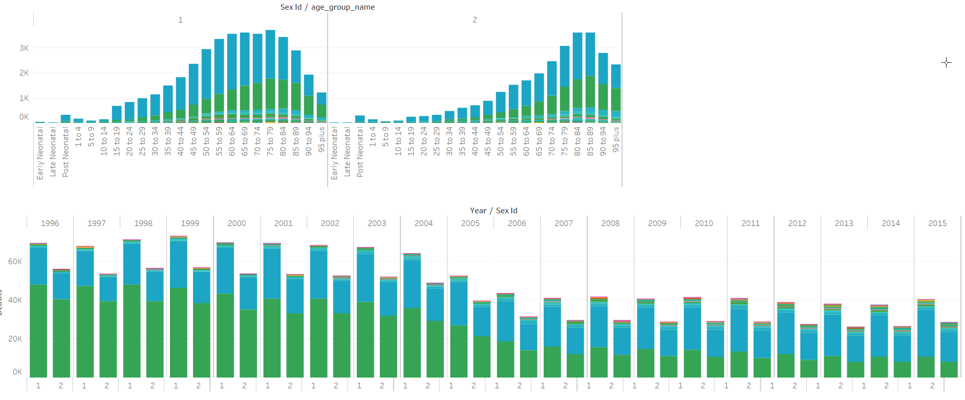
Brazil- code combination of impossible cause of death -2015
R-99 Ill-defined and unknown cause of mortality- 40000 death in 2015
R-98 Unattended death 18000 death in 2015

Slide 13
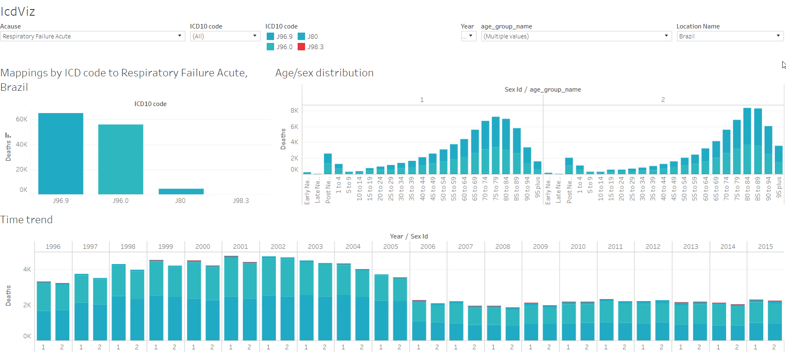
Acute respiratory failure in Brazil

Slide 14
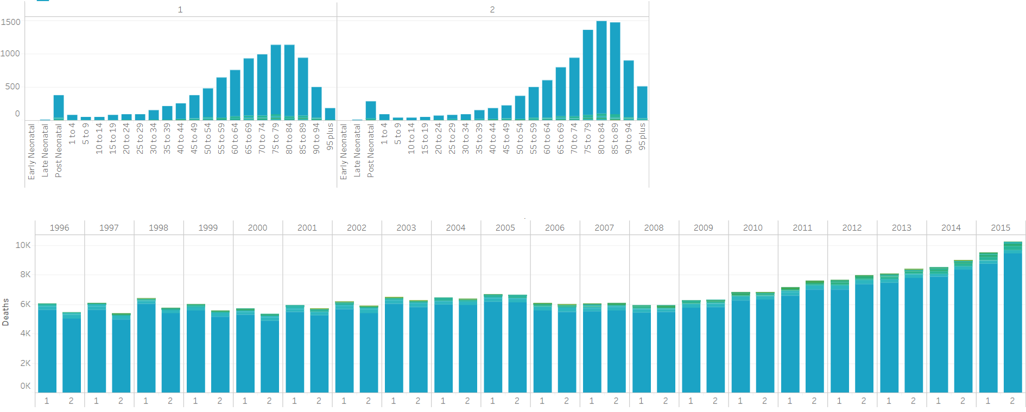
Brazil- code combination of Sepsis -2015
A41.9 Sepsis, unspecified organism

Slide 15
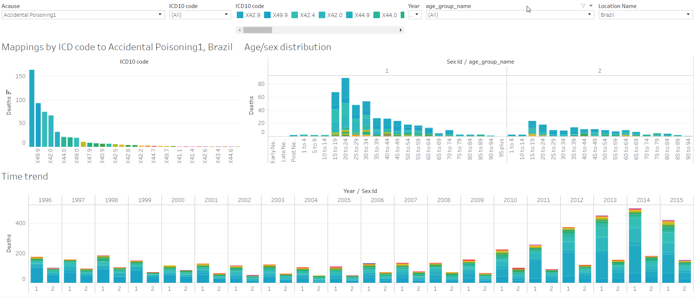
Unintentional poisoning in Brazil

Slide 16
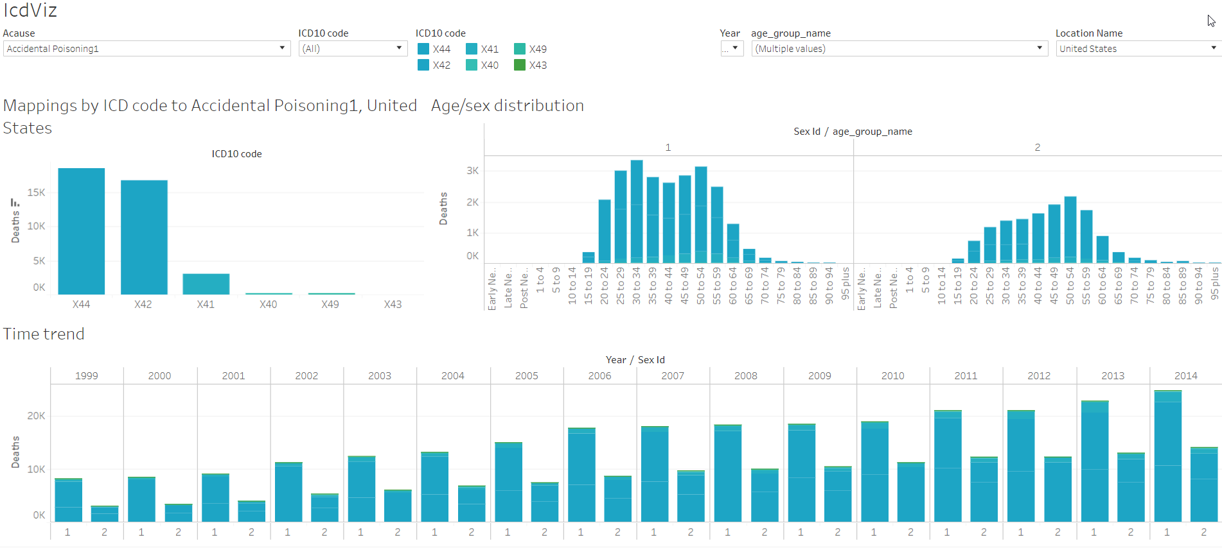
Unintentional poisoning in USA

Slide 17
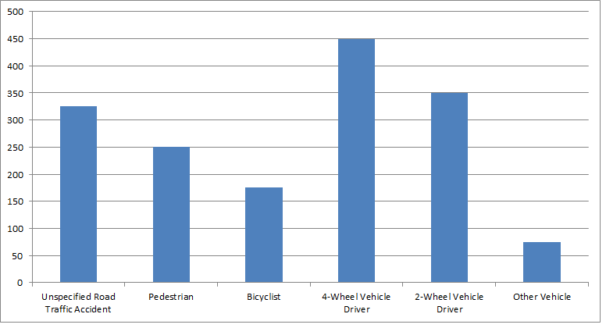
Redistribution of Garbage Codes

Slide 18
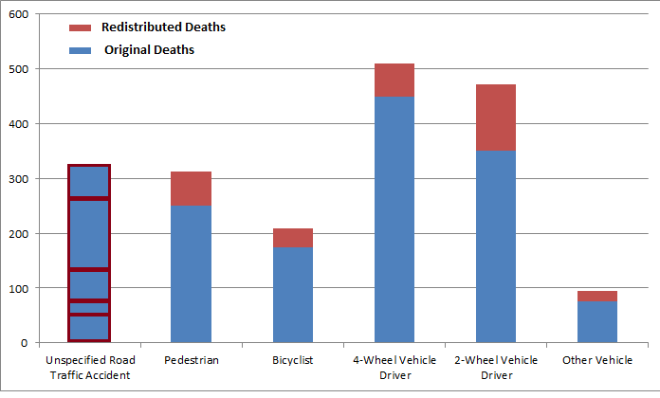
Redistribution of Garbage Codes

Slide 19
Principal and method for correction of GC
1- All ICD codes identified as “garbage codes” should be reassigned to a specific “target code”
2- Each GC have to redistribute by age, sex, year, country on target codes, in their ICD revision
3- Finding of target for each GC is based on :
  Understanding of diseases classification
  Understand Pathology and epidemiology of each GC and targets
  Based on literature review , multiple cause, fallow back study and hospital

Slide 20
Principal and method for correction of GC
4- Garbage in the injury Chapter XX redistribute on external causes (X59, Y34)
  But Garbage from Other Chapters on external causes (species , peritonitis) .
  Garbage in Cancer just redistribute on cancer chapter
  Miss coding in injuries move to other chapter (unintentional poisoning by alcohol)
5- how we have to redistribute on Targets
    Proportionally (Ill defined code redistribute on all causes)
    Just based on Negative correlation between target and GC (all cancer and injuries GC and most CVD GC)
    Just based on Multiple causes of death (miss coding of overdoses )
    Fix proportion : Based on literature review , multiple cause, Fallow back study(sepsis, peritonitis , renal failure ..)

Slide 21
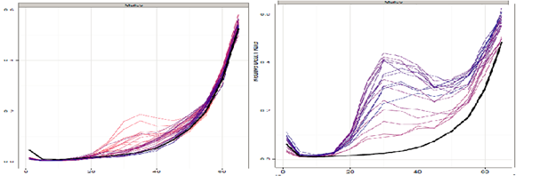

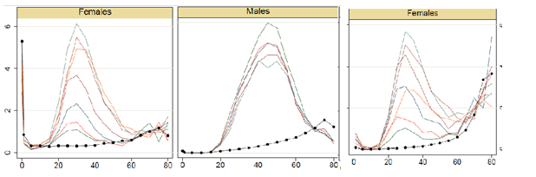
Toxoplasmosis –USA
Critical challenges: Mysteries of HIV in COD
New York State :USA -M
Limpopo :South Africa-F
  Comparing age-sex-cause-specific relative death rate of suspected with global standard relative age patterns by sex and GBD cause , Pooled from all available years of ICD9- and 10-coded in vital registration
Meningitis ZAF
TB- UKR
Inflammatory Bowel Diseases ZAF

Slide 22
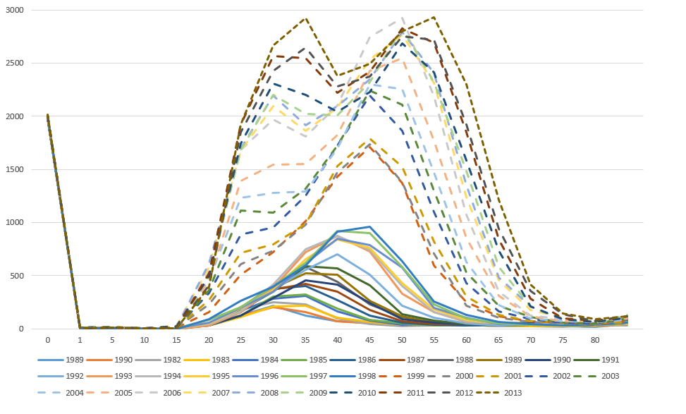
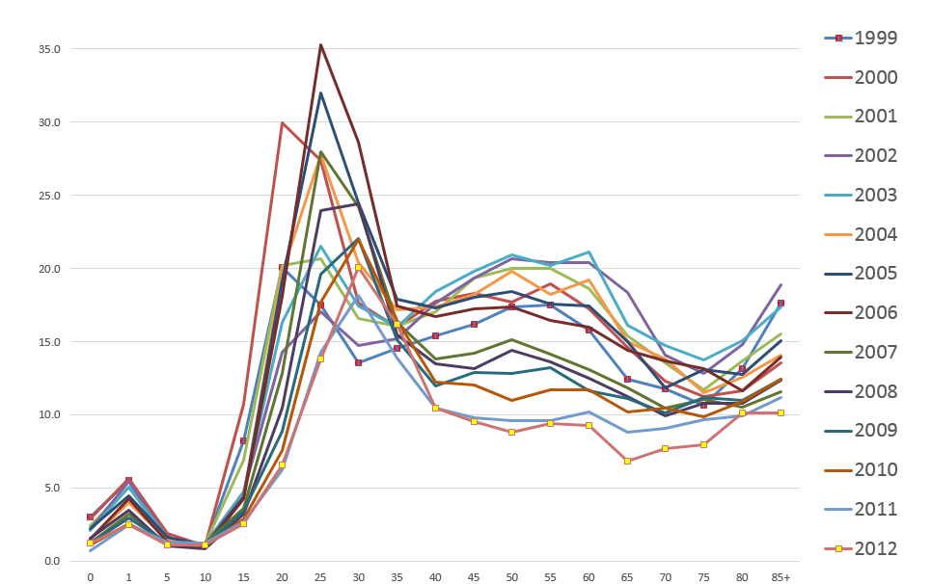
Critical challenges: Miss assignment of some causes
Number of death by age and year for unintentional unspecified poising in USA
Age specific mortality rate in Russia data for Other unintentional poisoning(X40-X44, X46-X49)

Slide 23
Number of Packages for redistribution of Garbage Codes by types in different coding system
Package Type | Proportional | Regression | Multiple causes | Fixed Proportion | total
ICD10 | 67 | 43 | 2 | 47 | 159
ICD9_detail | 81 | 31 | 1 | 30 | 143
ICD10_tabulated | 33 | 42 | 1 | 36 | 112
ICD9_BTL | 41 | 24 | 1 | 23 | 89
ICD9_USSR_Tabulation | 3 |  | 1 | 16 | 20
India_MCCD_states_ICD10 | 9 | 12 | 1 | 7 | 29
India_MCCD_states_ICD9 | 7 | 9 | 1 | 6 | 23
ICD8 A tabulated | 5 |  | 1 | 20 | 26
total | 246 | 161 | 9 | 185 | 601

Slide 24
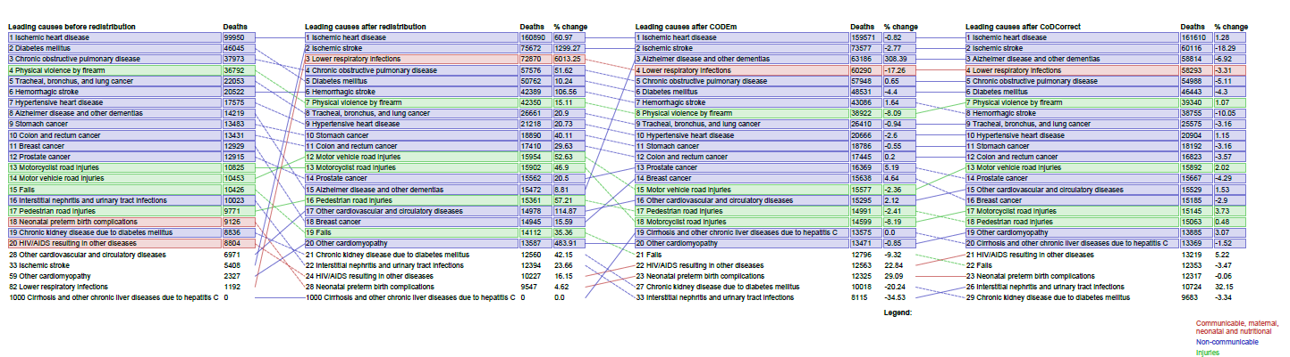
Brazil 2010 raw data and final estimation

Slide 25
Classification of GCs based on underlying cause or based on targets for their redistribution
GC level 1 :
Underlying causes (target for redistribution of these GC) are in at least in the 2 levels one cause (sepsis , Heart failure, senility, unknown causes of death ) – redistribute on different level 1 causes
Group A: Communicable, maternal, perinatal and nutritional conditions
On the level 1
Group B: Non communicable diseases
Group C: Injuries

Slide 26
Classification of GCs based on underlying cause or based on targets for their redistribution
GC level 1 :
Underlying causes (target for redistribution of these GC) are in at least in the 2 levels one cause (sepsis , Heart failure, senility, unknown causes of death ) – redistribute on different level 1 causes
GC level two:
Underlying causes (target for redistribution of these GC) are in one of the cause in level one (GI Bleeding , Unspecified Factor X59 , all of undetermined intent injuries , Unspecified Infectious D ) – redistribute on different level 2 causes
Diarrhea, lower respiratory, and other common infectious diseases
HIV/AIDS and tuberculosis
Neglected tropical diseases and malaria
On the level 2
Cardiovascular and circulatory diseases
Neoplasm
Chronic respiratory diseases
Transport Injuries
Unintentional injuries
Intentional injuries

Slide 27
Classification of GCs based on underlying cause or based on targets for their redistribution
GC level 1 :
Underlying causes (target for redistribution of these GC) are in at least in the 2 levels one cause (sepsis , Heart failure, senility, unknown causes of death ) – redistribute on different level 1 causes
GC level two:
Underlying causes (target for redistribution of these GC) are in one of the cause in level one (GI Bleeding , Unspecified Factor X59 , all of undetermined intent injuries , Unspecified Infectious D ) – redistribute on different level 2 causes
GC level three :
Underlying causes (target for redistribution of these GC) are in one of the cause in level 2 ( all unspecified Cancer site , and most of unspecified in the chapter ) – redistribute on different level 3 causes
Diarrhea, lower respiratory, and other common infectious diseases
On the level 3
HIV/AIDS and tuberculosis
Neglected tropical diseases and malaria
Neoplasm
Cardiovascular and circulatory diseases

Slide 28
Classification of GCs based on underlying cause or based on targets for their redistribution
GC level 1 :
Underlying causes (target for redistribution of these GC) are in at least in the 2 levels one cause (sepsis , Heart failure, senility, unknown causes of death ) – redistribute on different level 1 causes
GC level two:
Underlying causes (target for redistribution of these GC) are in one of the cause in level one (GI Bleeding , Unspecified Factor X59 , all of undetermined intent injuries , Unspecified Infectious D ) – redistribute on different level 2 causes
GC level three :
Underlying causes (target for redistribution of these GC) are in one of the cause in level 2 ( all unspecified Cancer site , and most of unspecified in the chapter ) – redistribute on different level 3 causes
GC level 4 :
Underlying causes (target for redistribution of these GC) are in one of the cause in level 3 (Unspecified Road Injuries, Unspecified lower respiratory infectious , Unspecified Stroke ) –redistribute on different level 4 causes
Cerebrovascular disease
On the level 4
Road injury
Lower respiratory infectious

Slide 29
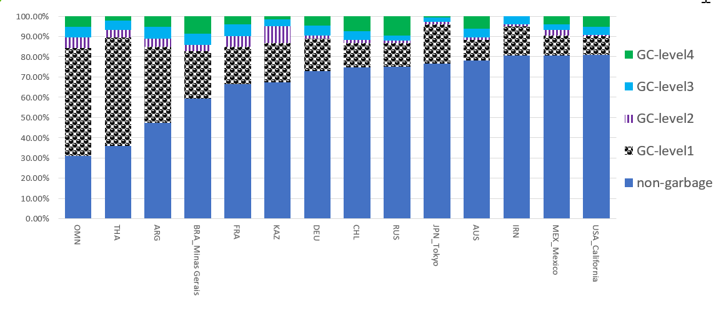
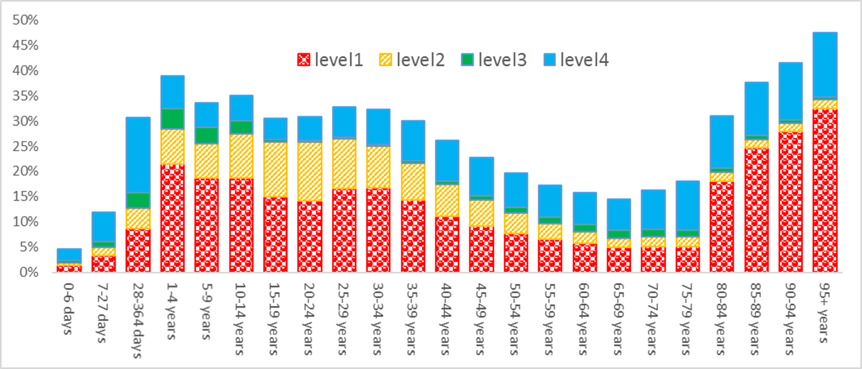
Fraction of GC based on level of redistribution on GBD cause , By countries just 2010
Russia Causes of death data by GCs level both sexes by ages 2014

Slide 30
VR data by state comparison between 2005 and 2015 for percent decrease in GC level 1 and level2-Brazil- sorted based on difference

Slide 31
Percent of GC level1&2 in Death registration system in Brazil by states for three last years

Slide 32
year | Argentina | Bolivia | Brazil | Chile | Colombia | Ecuador | El Salvador | Guatemala | Mexico | Nicaragua | Panama | Paraguay | Peru | Uruguay | Venezuela
'80 | 24% |  | 35% | 27% | 24% | 29% |  | 20% | 26% |  | 26% | 36% | 23% | 24% | 28%
'81 | 24% |  | 35% | 26% | 25% | 28% | 27% | 27% | 25% |  | 27% | 35% | 23% | 23% | 28%
'82 | 28% |  | 34% | 26% | 23% | 28% | 31% |  | 23% |  | 25% | 37% | 24% | 23% | 28%
'83 | 30% |  | 35% | 24% | 21% | 29% | 40% |  | 22% |  | 26% | 39% | 26% | 25% | 20%
'84 | 31% |  | 36% | 26% | 21% | 29% | 39% | 25% | 22% |  | 26% | 40% |  | 26%
'85 | 31% |  | 35% |  | 21% | 29% |  |  | 21% |  | 25% | 39% |  | 25% | 30%
'86 | 30% |  | 34% | 25% | 21% | 29% |  | 28% | 21% |  | 24% | 35% | 50% | 25% | 30%
'87 | 30% |  | 34% | 25% | 20% | 29% |  | 28% | 20% |  | 23% | 36% | 53% | 25% | 27%
'88 | 30% |  | 34% | 25% | 20% | 28% |  | 29% | 19% | 22% | 26% | 36% | 49% | 25% | 26%
'89 | 30% |  | 33% | 25% | 20% | 29% |  | 30% | 18% | 23% | 25% | 34% | 49% | 24% | 26%
'90 | 31% |  | 32% | 24% | 19% | 29% | 35% | 29% | 17% | 21% |  | 34% | 51% | 24% | 18%
'91 | 32% |  | 32% | 24% | 19% | 28% | 33% | 32% | 17% | 22% |  | 32% | 52% | 21%
'92 | 33% |  | 33% | 24% | 18% | 28% | 34% | 33% | 17% | 22% |  |  | 46% |  | 18%
'93 | 33% |  | 33% | 24% | 16% | 28% | 34% | 34% | 17% | 22% |  |  |  | 26% | 19%
'94 | 32% |  | 32% | 21% | 16% | 33% |  | 31% | 16% | 23% |  | 26% | 50% | 25% | 18%
'95 | 34% |  | 31% | 21% | 17% | 33% | 32% | 30% | 16% |  |  | 28% | 42% | 26%
'96 | 33% |  | 28% | 20% | 17% | 28% | 30% | 30% | 16% | 23% | 30% | 26% | 41% | 26% | 13%
'97 | 33% |  | 27% | 16% | 17% | 33% | 32% | 29% | 15% | 17% | 29% | 32% | 43% | 20% | 13%
'98 | 32% |  | 28% | 15% | 12% | 33% | 32% | 29% | 14% | 15% | 18% | 31% | 40% | 21% | 13%
'99 | 33% |  | 28% | 15% | 11% | 34% | 29% | 30% | 13% | 14% | 16% | 33% | 36% | 22% | 12%
'00 | 33% | 73% | 27% | 13% | 10% | 33% | 28% | 29% | 12% | 15% | 15% | 32% | 31% | 20% | 11%
'01 | 33% | 71% | 26% | 11% | 10% | 33% | 29% | 30% | 13% | 13% | 15% | 30% | 33% | 20% | 10%
'02 | 34% | 70% | 26% | 10% | 10% | 35% | 30% | 28% | 12% | 12% | 13% | 32% | 32% | 21% | 11%
'03 | 33% | 67% | 25% | 9% | 10% | 33% | 31% | 28% | 12% | 11% | 15% | 32% | 30% | 22% | 11%
'04 | 33% |  | 24% | 9% | 10% | 30% | 29% | 29% | 12% | 11% | 16% | 28% | 30% | 22% | 11%
'05 | 33% |  | 22% | 9% | 11% | 29% | 28% | 29% | 12% | 11% | 15% | 27% | 61% | 21% | 10%
'06 | 33% |  | 20% | 9% | 11% | 27% | 29% | 29% | 12% | 12% | 16% | 24% | 64% | 22% | 11%
'07 | 34% |  | 19% | 10% | 11% | 26% | 31% | 29% | 13% | 13% | 14% | 26% | 24% | 23% | 11%
'08 | 34% |  | 19% | 10% | 11% | 28% | 32% | 28% | 12% | 13% | 14% | 25% | 25% | 23% | 11%
'09 | 34% |  | 19% | 10% | 11% | 25% | 31% | 25% | 12% | 11% | 15% | 24% | 27% | 24% | 12%
'10 | 34% |  | 18% | 11% | 11% | 26% | 33% | 24% | 12% | 11% | 17% | 23% | 26% | 24% | 11%
'11 | 35% |  | 18% | 10% | 12% | 26% | 31% | 23% | 12% | 9% | 17% | 21% | 25% |  | 11%
'12 | 34% |  | 18% | 10% | 11% | 25% | 33% | 22% | 12% | 10% | 16% | 22% | 25% | 26% | 11%
'13 | 34% |  | 18% | 11% | 10% | 23% | 36% | 22% | 12% | 9% | 17% | 21% | 25% | 24% | 11%
'14 | 32% |  | 17% | 11% |  | 21% |  | 22% | 11% |  | 16% | 21% | 24% | 24%
'15 |  |  | 18% |  |  |  |  |  | 11%
Fraction of GC level 1 &2 in some Latin America countries by year

Slide 33
ihme_loc_id | number drop | ihme_loc_id | number drop
BOL | 4 | IND_Arunchal Pradesh, Urban | 23
BRA_Acre | 3 | IND_Biha r, Urban | 6
BRA_Alagoas | 17 | IND_Delhi, Urban | 16
BRA_Bahia | 8 | IND_Punjab, Urban | 2
BRA_Cear | 16 | IND_Rajasthan, Urban | 6
BRA_Maranho | 21 | IND_Sikkim, Urban | 15
BRA_Mato Grosso | 1 | IRN | 7
BRA_Paraya | 23 | LKA | 1
BRA_Pernambuco | 23 | MAR | 6
BRA_Piaui | 11 | MDV | 6
BRA_Rio Grande do Norte | 11 | OMN | 1
BRA_Sergipe | 14 | PER | 7
BRA_Tocantins | 3 | SAU_'Asir | 4
CHN_Hainan | 1 | SAU_Bahah | 1
CHN_Qinghai | 1 | SAU_Eastern Province | 11
CHN_Xinjiang | 1 | SAU_Ha'il | 1
CYP | 2 | SAU_Jizan | 1
EGY | 11 | SAU_Madinah | 12
FJI | 1 | SAU_Makkah | 3
GEO | 3 | SAU_Najran | 1
GRD | 3 | SAU_Northern Borders | 3
HND | 3 | SAU_Riyadh | 11
HTI | 3 | SAU_Tabuk | 7
THA | 25 | SYR | 5
TUR | 22
387 location year with more than 50% Garbage Codes level 1 and level 2 dropped from Causes of death Data base in GBD 2016 (BRA -151 years location from 962)

Slide 34
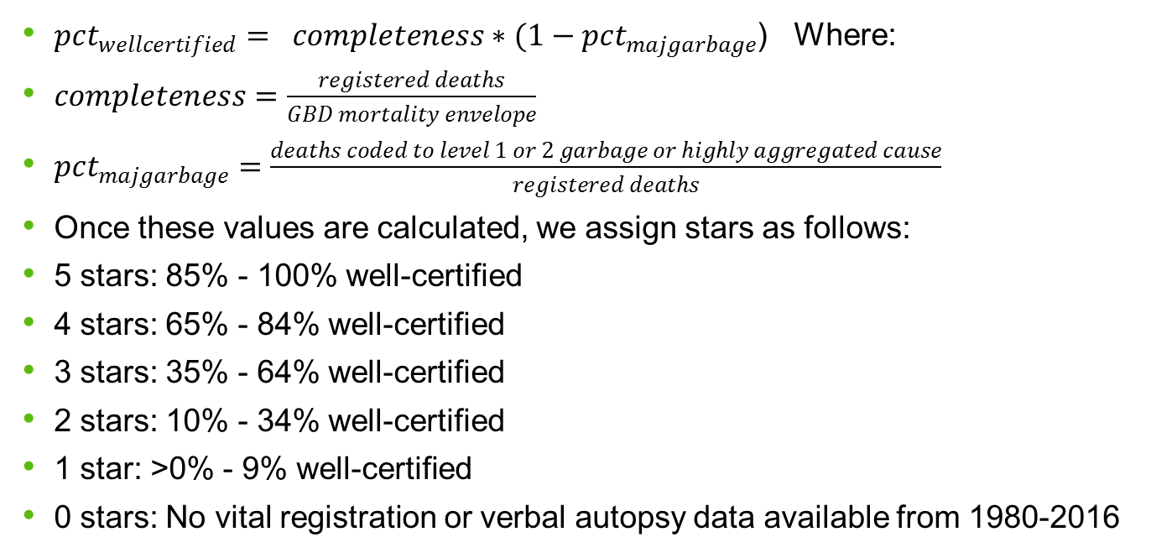
$pct_{wellcertified}= completeness∗(1−pct_{majgarbage}$) Where:
$completeness=\frac{registered deaths}{GBD mortality envelope}$
$pct_{majgarbage}=\frac{deaths coded to level 1 or 2 garbage or highly aggregated cause}{registered deaths}$
Once these values are calculated, we assign stars as follows:
5 stars: 85% - 100% well-certified
4 stars: 65% - 84% well-certified
3 stars: 35% - 64% well-certified
2 stars: 10% - 34% well-certified
1 star: >0% - 9% well-certified
0 stars: No vital registration or verbal autopsy data available from 1980-2016

Slide 35
Data quality rating from 0 to 5 stars, maximum percent well certified per 5-year interval and percent well certified across time series for 199 countries, 1980-2016.
Country | Data Quality Rating | 1980-1984 | 1985-1989 | 1990-1994 | 1995-1999 | 2000-2004 | 2005-2009 | 2010-2016
Costa Rica | 5 | 79.8 | 81.8 | 80.2 | 91.2 | 91.8 | 89.8 | 90.8
Chile | 4 | 75.5 | 75.1 | 76.6 | 84.8 | 90.9 | 90.3 | 90
Venezuela | 4 | 79.2 | 74.3 | 81.9 | 87.8 | 89.9 | 89.5 | 89
Mexico | 4 | 65.2 | 71.9 | 72.7 | 76.7 | 79.4 | 81.7 | 88.1
Colombia | 4 | 71.7 | 73.3 | 75.3 | 84.5 | 86 | 86.3 | 87.8
Brazil | 4 | 58.3 | 62.4 | 65 | 69.8 | 75 | 80.4 | 82.7
Guyana | 4 | 51.5 | 71.7 | 64 | 66.2 | 79 | 77.7 | 73.5
Guatemala | 4 | 79.2 | 70.5 | 71.5 | 70.8 | 67.9 | 70.7 | 73.4
Ecuador | 4 | 71.6 | 68.1 | 67.7 | 63.7 | 61.6 | 66.4 | 68.2
Argentina | 4 | 76.5 | 69.8 | 68.5 | 67.6 | 66.7 | 65.6 | 67.8
Nicaragua | 3 | 0 | 55.8 | 59.4 | 66.1 | 71.7 | 78.7 | 84.9
Paraguay | 3 | 55.1 | 51.4 | 59 | 62.6 | 60 | 62.6 | 65.7
El Salvador | 3 | 72.8 | 0 | 57.8 | 63.4 | 65.6 | 66.6 | 64
Peru | 3 | 58.9 | 34.4 | 36.5 | 48.2 | 60.3 | 60.2 | 60.4
Honduras | 2 | 31.7 | 36.9 | 35.6 | 0.4 | 0 | 12.4 | 13.9
Bolivia | 1 | 0 | 0 | 0 | 0 | 12.4 | 0 | 0

Slide 36
 | 1980-1984 |  | 1985-1989 |  | 1990-1994 |  | 1995-1999 |  | 2000-2004 |  | 2005-2009 |  | 2010-2015
 | stars | Well-Cer | stars | Well-Cer | stars | Well-Cer | stars | Well-Cer | stars | Well-Cer | stars | Well-Cer | stars | Well-Cer
Esprito do Santo | 4 | 67% | 4 | 67% | 4 | 70% | 4 | 70% | 4 | 85% | 5 | 89% | 5 | 93%
Distrito Federal | 4 | 82% | 5 | 90% | 5 | 89% | 5 | 90% | 5 | 89% | 5 | 90% | 5 | 91%
Mato Grosso do Sul | 4 | 72% | 4 | 74% | 4 | 75% | 4 | 76% | 5 | 89% | 5 | 90% | 5 | 91%
GoiÃ¡s | 3 | 55% | 3 | 61% | 4 | 66% | 4 | 70% | 4 | 82% | 4 | 81% | 5 | 87%
ParanÃ¡ | 4 | 71% | 4 | 75% | 4 | 78% | 4 | 82% | 4 | 85% | 5 | 86% | 5 | 86%
Rio Grande do Sul | 4 | 75% | 4 | 76% | 4 | 79% | 4 | 84% | 4 | 85% | 5 | 86% | 5 | 86%
Tocantins | 0 | 0% | 0 | 0% | 3 | 38% | 3 | 53% | 4 | 73% | 4 | 79% | 5 | 86%
Rio Grande do Norte | 2 | 32% | 3 | 40% | 3 | 45% | 3 | 55% | 4 | 66% | 4 | 83% | 5 | 85%
Santa Catarina | 3 | 62% | 4 | 72% | 4 | 73% | 4 | 77% | 4 | 79% | 4 | 84% | 5 | 85%
Mato Grosso | 3 | 44% | 3 | 51% | 3 | 50% | 4 | 77% | 4 | 79% | 4 | 85% | 5 | 85%
Pernambuco | 3 | 42% | 3 | 47% | 3 | 57% | 3 | 63% | 4 | 72% | 4 | 83% | 5 | 85%
Piaui | 2 | 30% | 2 | 33% | 3 | 40% | 3 | 42% | 3 | 58% | 4 | 80% | 5 | 85%
Alagoas | 2 | 34% | 3 | 37% | 3 | 36% | 3 | 52% | 3 | 59% | 4 | 77% | 4 | 84%
Roraima | 4 | 70% | 4 | 68% | 4 | 74% | 4 | 84% | 4 | 85% | 4 | 84% | 4 | 84%
SÃ£o Paulo | 4 | 80% | 4 | 79% | 4 | 79% | 4 | 82% | 4 | 82% | 4 | 83% | 4 | 84%
Sergipe | 2 | 34% | 2 | 33% | 3 | 57% | 3 | 54% | 4 | 74% | 4 | 81% | 4 | 84%
Brazil | 3 | 58% | 3 | 62% | 3 | 65% | 4 | 70% | 4 | 75% | 4 | 80% | 4 | 83%
MaranhÃ£o | 2 | 18% | 2 | 21% | 2 | 22% | 2 | 28% | 3 | 44% | 4 | 72% | 4 | 83%
Acre | 3 | 40% | 3 | 50% | 3 | 51% | 3 | 50% | 3 | 56% | 4 | 70% | 4 | 82%
AmapÃ¡ | 4 | 78% | 4 | 77% | 4 | 75% | 4 | 75% | 4 | 76% | 4 | 76% | 4 | 82%
RondÃ´nia | 4 | 73% | 4 | 76% | 4 | 74% | 4 | 72% | 4 | 76% | 4 | 80% | 4 | 82%
CearÃ¡ | 2 | 24% | 2 | 28% | 3 | 37% | 3 | 58% | 3 | 59% | 4 | 75% | 4 | 81%
ParÃ¡ | 3 | 47% | 3 | 47% | 3 | 47% | 3 | 51% | 3 | 59% | 4 | 71% | 4 | 81%
ParaÃ­ba | 2 | 34% | 3 | 36% | 3 | 36% | 3 | 39% | 3 | 56% | 4 | 77% | 4 | 81%
Rio de Janeiro | 4 | 72% | 4 | 74% | 4 | 76% | 4 | 77% | 4 | 77% | 4 | 78% | 4 | 80%
Amazonas | 3 | 59% | 3 | 57% | 3 | 54% | 3 | 63% | 4 | 66% | 4 | 73% | 4 | 79%
Minas Gerais | 4 | 67% | 4 | 67% | 4 | 66% | 4 | 70% | 4 | 74% | 4 | 75% | 4 | 78%
Bahia | 3 | 39% | 3 | 41% | 3 | 45% | 3 | 47% | 3 | 53% | 4 | 68% | 4 | 73%

Slide 37
What will be new in GBD 2017
In redistribution of GCs we will have uncertainty around each cause based on fraction that get from GCs , by age, sex, year , location
In redistribution of GCs we will have just 2 type of redistribution
  a- redistribution based on regression between GC and target
  b- redistribution based relative risk of assignment of true causes to the GC
  - this relative risk comes from multiple causes of death analysis (USA, Brazil, New Zeeland,….)
  - this relative risk weighted by frequency of target in each country

Slide 38
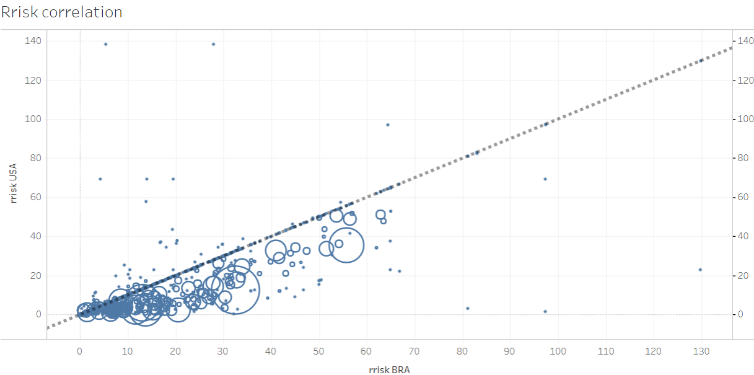
Relative risk of assignment of each causes to sepsis in USA and Brazil
Urinary nephritis
LRI

Slide 39
Thanks and any question or comment

